Slide 1
Psychology
Definition and laws of perception
Factors affection the perception
Ms. Noreena Younas ( week 4)

Slide 2




www.tuf.edu.pk
unioffaisalabad
What is Perception?
Perception in psychology can be defined as the sensory experience of the world, which includes how an individual recognizes and interpreter sensory information. This also includes how one responds to those stimuli. Perception includes these senses: vision, touch, sound, smell, taste, and proprioception.
.

Slide 3
www.tuf.edu.pk
unioffaisalabad
Importance of Perception
Perception is the way individuals recognize and interpret the environment. It is necessary for survival. For example, when one is walking on the street, an accurate and efficient perception of an out-of-control car that is speeding toward them will help them escape from possible injuries from getting hit. In this example, it involves the ability to see and hear the car and maybe people around shouting for the individual's attention.Then it requires the individual to put together all the perceptions of the car and derive meaning from them, ie. they should escape and stay away from the car. The individual will end up in danger if some of these skills are lacking.
.

Slide 4
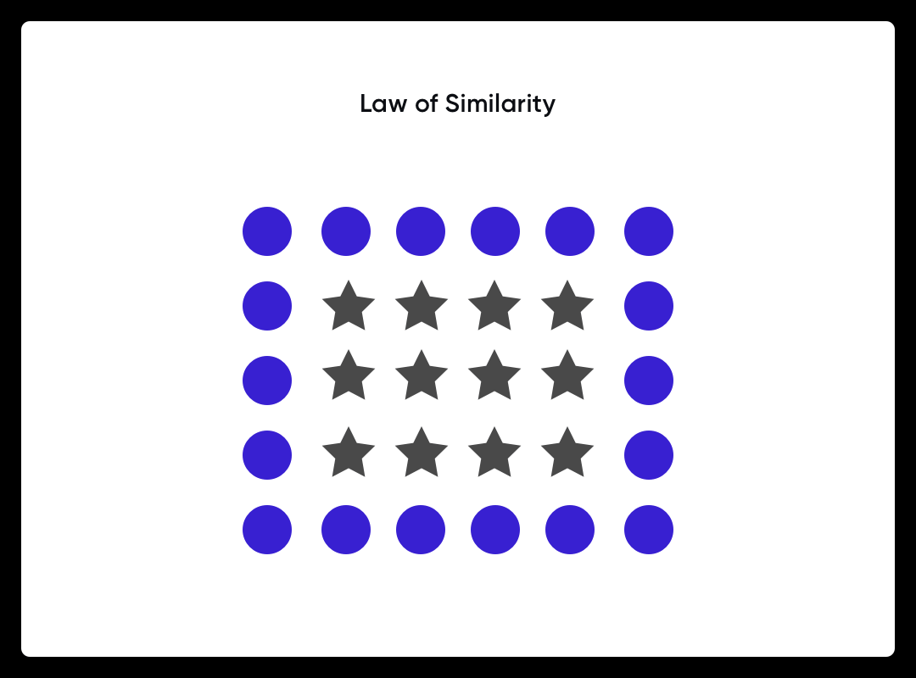
www.tuf.edu.pk
unioffaisalabad
1. Law of Similarity
1. Law of Similarity
1. Law of Similarity
This principle states that similar objects on the interface are often considered as a part of the same group, by the human eye. It is achieved by using similar shapes, sizes, or colors. It enables the user to figure out the functionality behind the various interface elements.
.

Slide 5



www.tuf.edu.pk
unioffaisalabad
Law of Similarity
e.g. If you look closely, you will see that the smiley face is made of individual characters. We are able to see each of the eyes and the mouth because they are made of similar characters that we combine in our minds using the law of the similarity.
e.g Birds of the same feather stick together
Birds of the same feather stick togetherBirds of the same feather stick togetherBirds of the same feather stick together

Slide 6
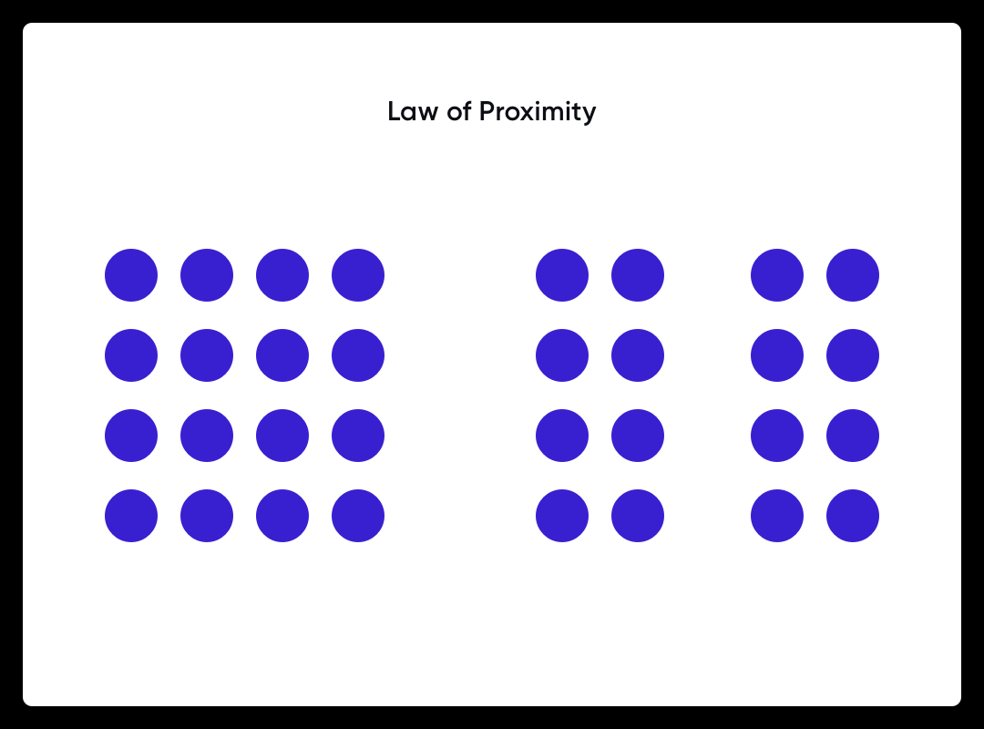
www.tuf.edu.pk
unioffaisalabad
2. Law of Proximity
The principle states, that the objects placed closed on an interface are perceived to be related to those set far apart. It can even override the similarity created by using the same colors or sizes. Sometimes placing the objects far apart creates a sense of negative space, which is useful to distinguish the objects from the rest..

Slide 7
www.tuf.edu.pk
unioffaisalabad
2. Law of Proximity
e.g putting a blank space between paragraphs in a report or academic paper helps the reader to understand that the next set of sentences will present a new idea.
e.g pair of students sitting together daily in class same consider to be friends.

Slide 8

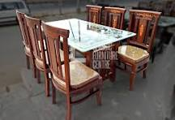

www.tuf.edu.pk
unioffaisalabad
Table and chairs in the dining room are placed near each other and referred to as “dining room table and chairs.” If placed in the kitchen, their label is changed to “kitchen table and chairs.” Each grouping consists of the same items (table and chairs), but they are perceived as distinct groups when positioned in separate areas.
People that sit near each other in a section of a stadium are perceived as cheering for the same team.

Slide 9
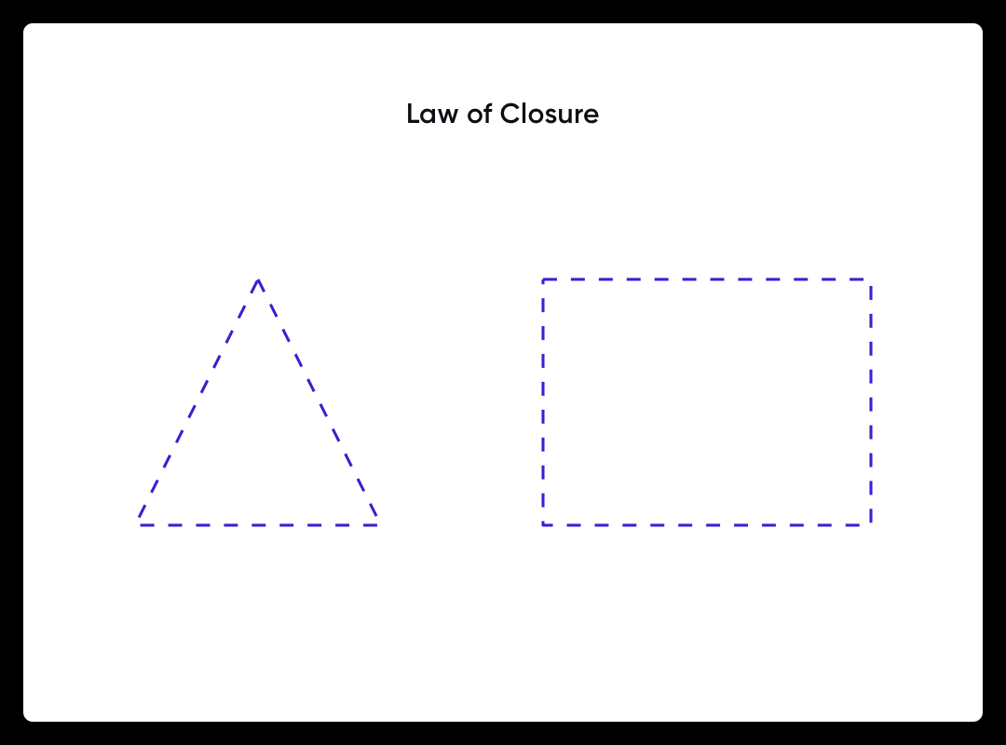
3. Law of Closure
www.tuf.edu.pk
unioffaisalabad
The principle states the eye can fulfill the gaps and patterns, perceiving the object as a whole. E.g., a triangle drawn using broken lines or empty spaces will still be understood as a triangle. This explains the brain’s capability of filling in the missing information to create recognizable details..

Slide 10
www.tuf.edu.pk
unioffaisalabad
What Is Closure? Closure is a feeling of finality or resolution that people seek after an event or a relationship comes to an end. When we talk about needing closure, it means we're looking for answers to unresolved matters holding us back, preventing us from moving forward until they're dealt with.
Child Father Example

Slide 11
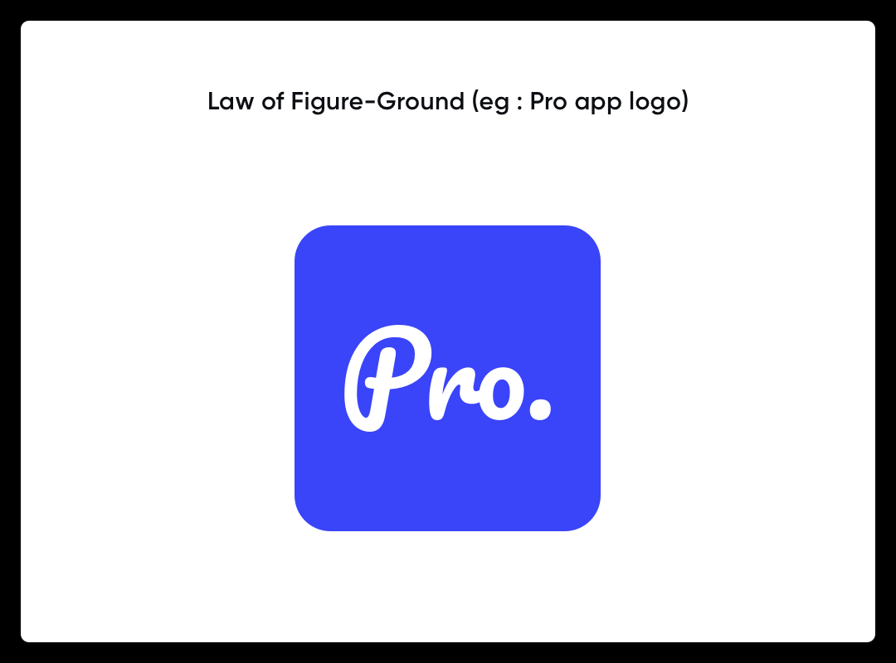
“
“
4. Law of Figure Ground
The principle states that we divide any visual into figure and ground. The image is of the pro app logo which refers to the object in the foreground with the focus, and the ground is the background of the visual. This law is widely used in creating logos for brands.
9. Political Sociology
This branch of sociology studies different political moments in society. It includes the study of different political ideologies of individuals, their origin, development and functions. In this study, different political parties are considered as social institutions. Various activities and behaviour of political parties are studied in this branch. It helps to understand the factors on which the political decisions are taken.

Slide 12
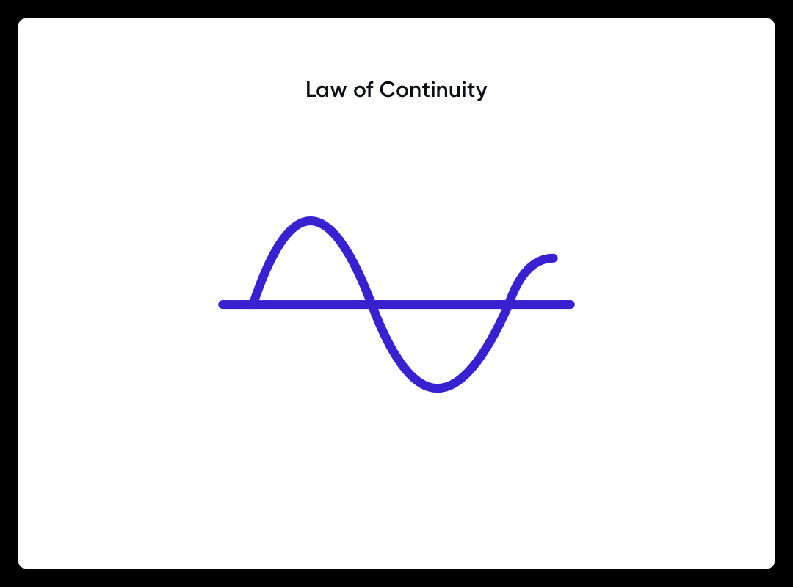
“
“
5. Law of Continuity
The eye tends to follow the objects placed on a straight or curved line more smoothly than at broken lines or angles. They are even perceived as connected and help in the smooth navigation of a website or an application.

Slide 13

www.tuf.edu.pk
unioffaisalabad
Examples
of continuity theory might include any instance of an older adult engaging in tasks, thoughts, or goals that align with their younger self. The theory asserts that older adults maintain similar patterns of behaviors and relationships as when they were young.
Continuity is that our brains tend to see objects as continuous or smooth rather than disjointed or discontinuous. A great example of this phenomenon is a movie.
Similar objects in a line, smooth flow of water like rivers, straight and uninterrupted roads are some of the examples of continuation in the real world

Slide 14
Factors effecting the Perception
Perception is a cognitive process that is used to understand and interpret information that we get from our senses, and certain factors affect perception, such as emotion, motivation, culture, and expectations.
External factors
Psychological factors

Slide 15
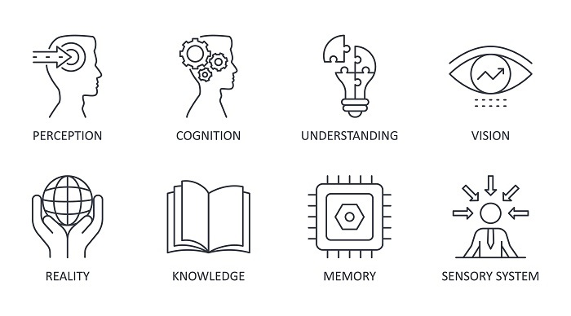
www.tuf.edu.pk
unioffaisalabad

Slide 16
www.tuf.edu.pk
unioffaisalabad
External Factors:
Intensity
The more intense something is, the more likely it is that it will be perceived. For example, people are more likely to perceive a loud noise rather than a quiet background noise.
Changes
When driving in a car, there are constant changes in visual stimuli. So, what we see/perceive constantly changes.
Magnitude
The larger the size of an object, the more likely it is to be seen/perceived.

Slide 17
www.tuf.edu.pk
unioffaisalabad
Repetition
Repetition increases our sensitivity to the stimuli. This means that we become more aware of stimuli because it has been perceived frequently.
Psychological factors affecting perception
Motivation
We are more likely to perceive and see objects or aspects of objects that are of interest to us. Going to the shop when hungry can lead you to buy more food than you normally would

Slide 18
www.tuf.edu.pk
unioffaisalabad
Emotion
it is still debated how emotion affects perception. Generally, it is theorized that heightened states and emotions such as stress and anxiety can influence how much and what we perceive
Sad or happy feelings can affect how stimuli are interpreted when sad, we may notice events or situations that are more upsetting.
For example Selye's GAS (General Adaptation Syndrome) model suggests that senses are heightened when stressed due to a perceived threat. The body's response is to become hypervigilant (increased perception) so that the person can deal with the threat.

Slide 19
www.tuf.edu.pk
unioffaisalabad
Expectation
We have a tendency/bias to see things of how we expect to see them.
When someone thinks of an apple, they might expect it to be red or green. However, apples can also be yellow or white.
Culture
Social norms, rules, beliefs and standards set by the society/culture we live in can affect how stimuli are perceived. This can affect how we process and interpret information that is perceived.
Culture affects the type of stimuli children are exposed to. For example, in western societies, children may be accustomed to coloring in 2D images and seeing pictures and cartoons of people and objects, so tend to draw them in a 2D format.

Slide 20
www.tuf.edu.pk
unioffaisalabad
Individual Differences
Every person is unique and brings different attitudes to a team. You may work well when collaborating with others while your coworker prefers to work in isolation. Each of these differences affects your perception of your team and organization. You’ll behave differently when you’re working with your colleague as opposed to someone else. Your perception of your coworker shapes the way you work as well. In the workplace, it’s necessary to respect these differences and work with others to create harmony.
Past Experiences
Our past experiences shape us into who we are today. We can’t separate ourselves from them. Past experiences are also significant factors influencing perception. They shape our personal biases and opinions as well as our expectations from others and ourselves. It’s important to be open to changing our perceptions when situations change. For instance, the Earth wasn’t always considered to be round.

Slide 21
www.tuf.edu.pk
unioffaisalabad
Attitudes − Our attitudes towards anything or anyone have a great impact on our perception. And our attitudes are developed around our living background. Our childhood, our upbringing, and the nature of the people around us form and nurture our attitudes. So our attitude towards a particular target is one of the major factors that influence perception.
Motives − The motive behind anything helps to shape and sometimes distort our perception. Suppose we go for an interview and the motive behind the interview is to get an urgent job, we will perceive everything to be decent and good, and if we already have many options and our motive is to choose anyone among them, then we will start encountering good aspects as well as bad aspects.

Slide 22
www.tuf.edu.pk
unioffaisalabad
Interest − We perceive the target as favorable and good if we have an interest in it. For example, if we choose a particular college because it offers scholarships, we will perceive it to be better than other colleges.
Experience − Our experience and expertise also shape our perceptions. A particular child can view a cartoon as the best thing to enjoy, but a youngster may or may not have any interest in it; he or she may like rock music instead of that, and an old person may not have any interest in any of them. So years of experience shape and modulate our perception towards anything.

